Slide 1




OCTolyzer: fully automatic analysis for scanning laser ophthalmoscopy and optical coherence tomography data
Training session
Jamie Burke
February 2025

Slide 2
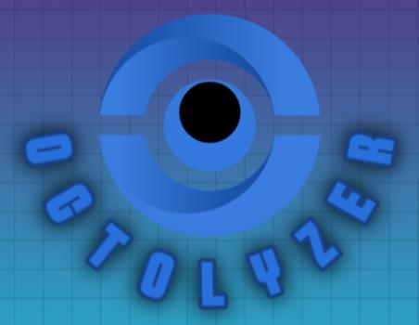
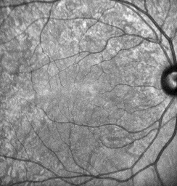
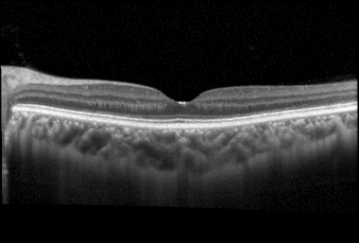
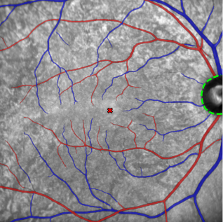
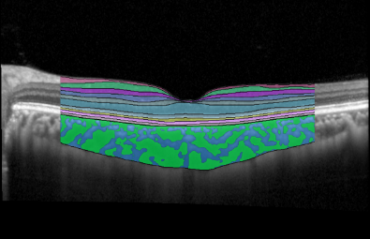
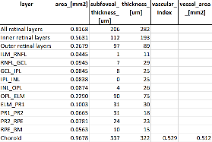
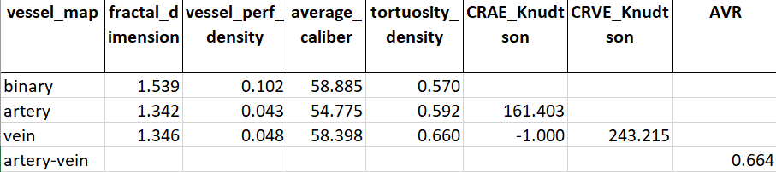
.vol file
OCTolyzer
OCT/SLO Metadata
SLOctolyzer
OCT Analysis Suite
SLO Analysis Suite
Segmentation module
Segmentation module
Measurement module
Measurement module
Complexity, Tortuosity, Calibre
Thickness, Area, Vascularity

Slide 3
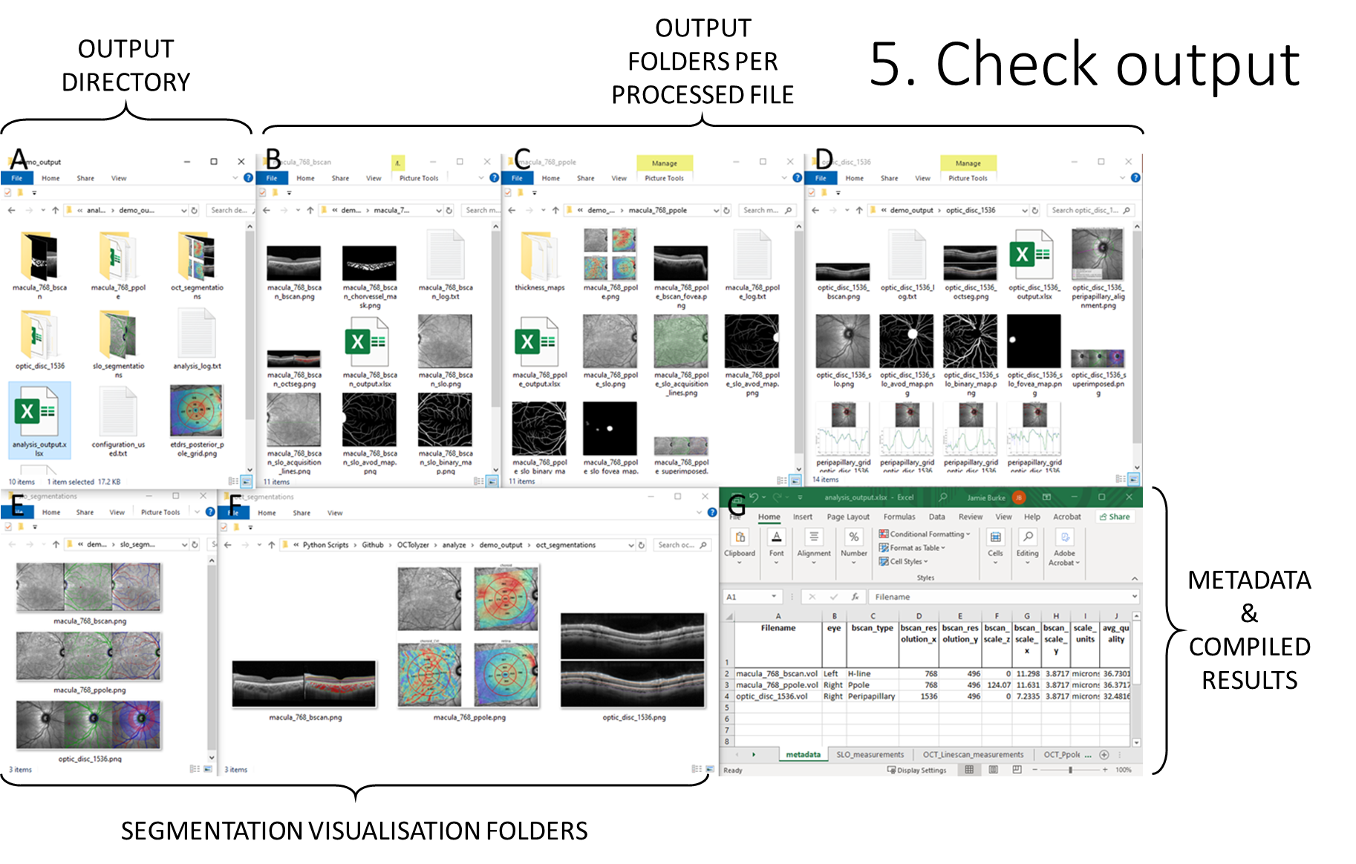
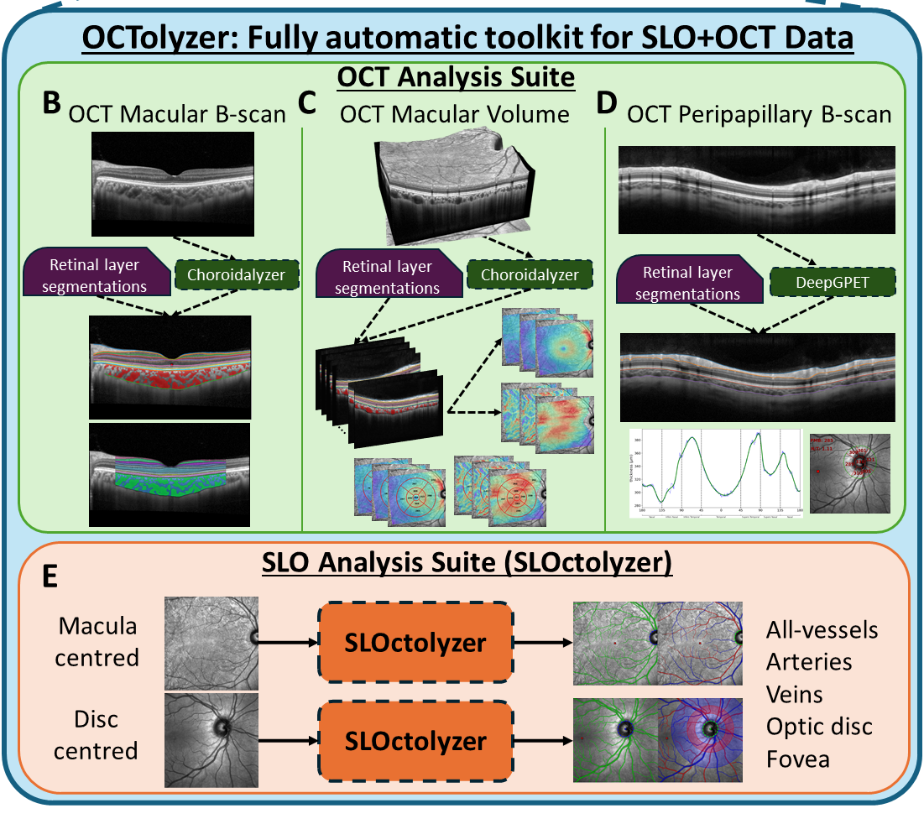
.vol file
OCT/SLO Metadata
OCTolyzer

Slide 4
Addressing immediate questions on OCTolyzer

Slide 5
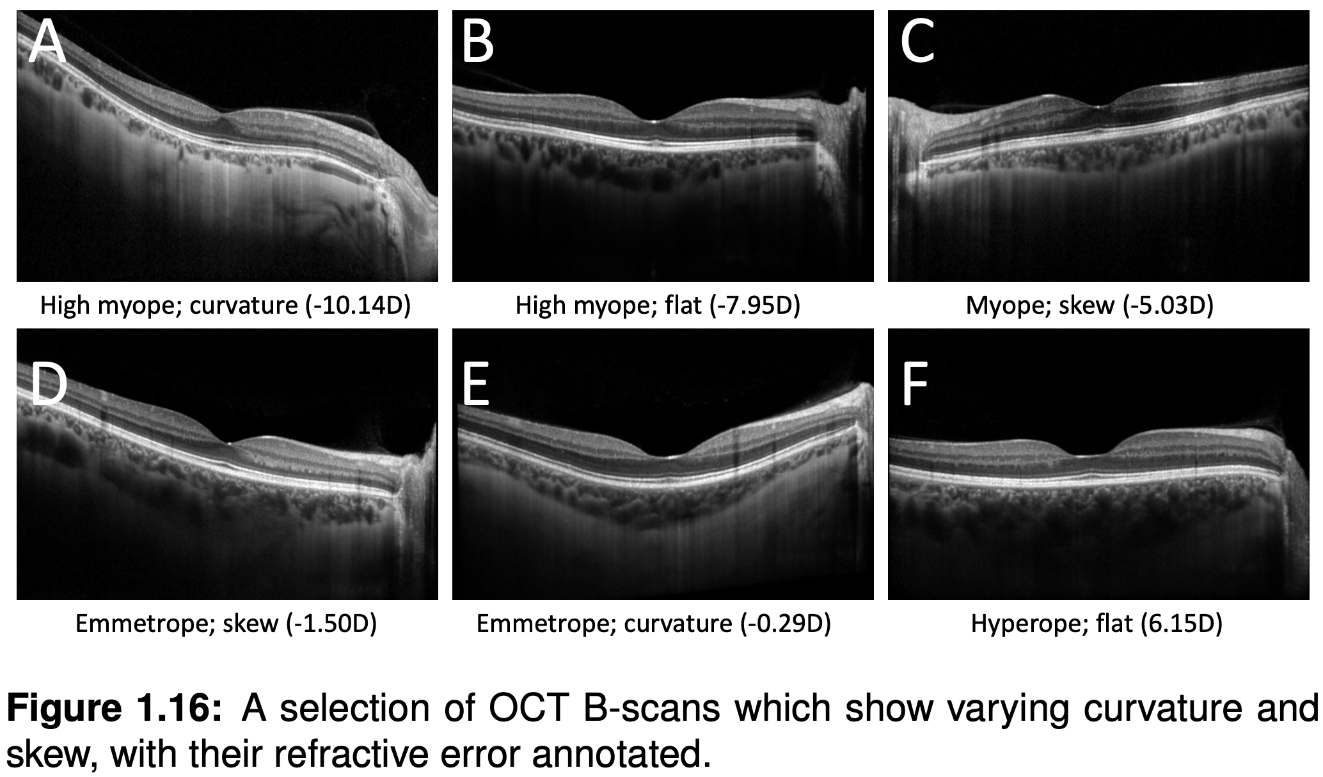
Measuring the choroid (1/3)
Across the refractive error spectrum, chorioretinal tissue may undergo skewness/curvature depending on eye shape, patient concentration and experience of the image technician.
When measuring the choroid and comparing population-level measurements, we want to account for any skewness/curvature exhibited by the chorioretinal tissue in the OCT B-scan.

Slide 6
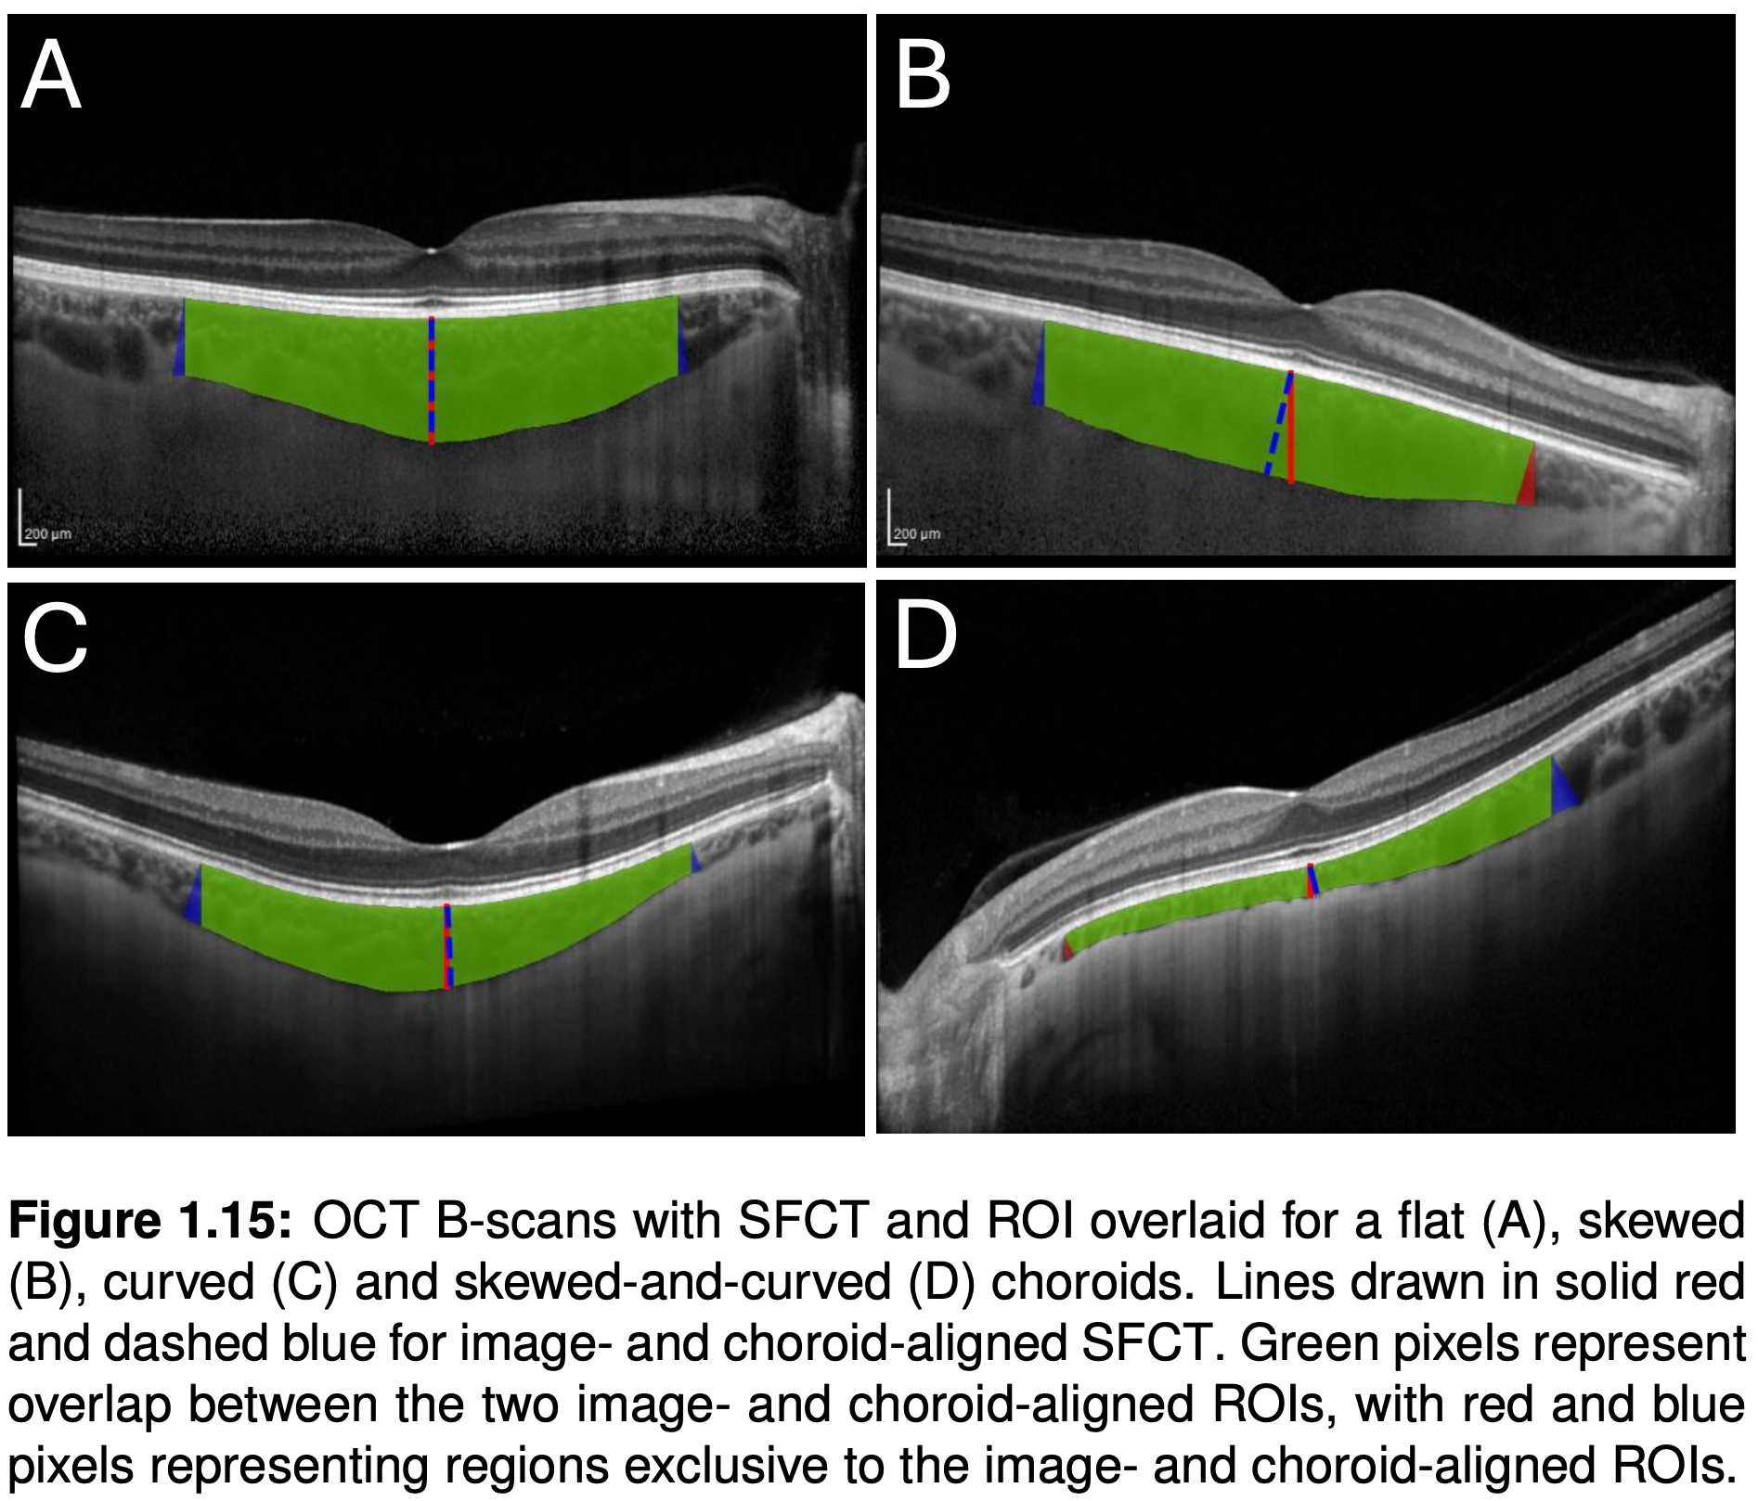
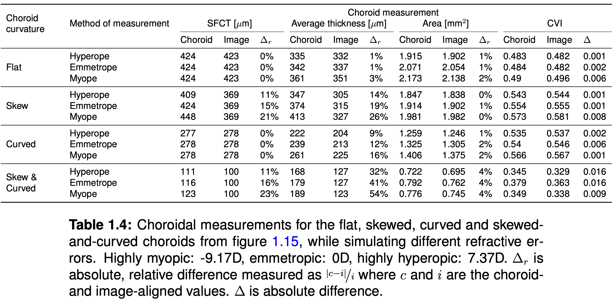
Measuring the choroid (2/3)
We take four exemplar choroids which exhibit flatness (A), skewness (B), curvature (C) and skewness/curvature (D)
And compare measurements of the choroids using a perpendicular approach (blue) and a vertical approach (red) using three example eye shapes.
Conclusion: B-scans exhibiting skewness/curvature have significantly different thickness measurements between perpendicular/vertical approaches. Two-dimensional metrics like area and CVI are more robust to skewness/curvature.

Slide 7
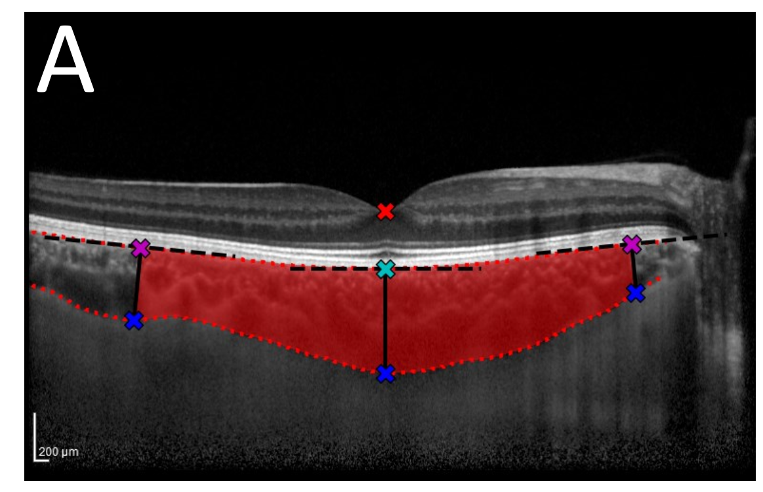
Measuring the choroid (3/3)
To measure the choroid we follow the steps animated below.
Identify the fovea xy-coordinate on the B-scan (red cross).
Identify the nearest xy-coordinate to the fovea on the RPE-Choroid boundary (cyan cross).
Identify endpoints of the region of interest (ROI) a given macula_rum microns away from the fovea (magenta cross).
Draw tangent line (black crossed) centred at each reference point (cyan/magenta cross), using offset (15px) defining gradient.
Rotate tangent lines 90-degrees (black solid), centred at each reference point (cyan/magenta cross), defining perpendicular reference lines.
Intersection of perpendicular lines and Choroid-Sclera boundary (blue cross) gives distance between upper/lower boundaries.
Distance (black solid) between magenta/blue crosses give thickness.
Column averaging takes several adjacent thickness measurements per reference point and averages over.
0 column averaging means that only one thickness measurement is taken per reference point.
Region (red) between endpoint-perpendicular lines give ROI to measure average thickness, area, CVI, etc.
1
3
2
4
5
6

Slide 8
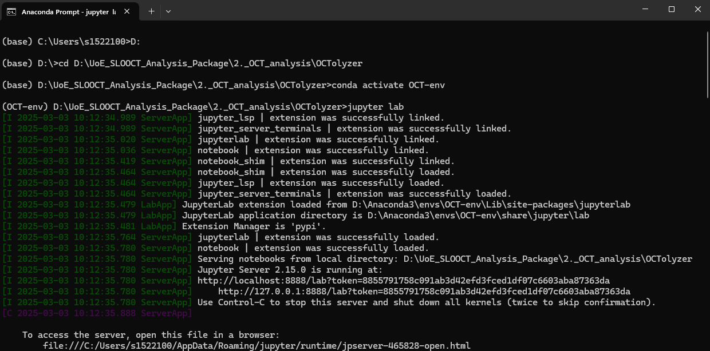
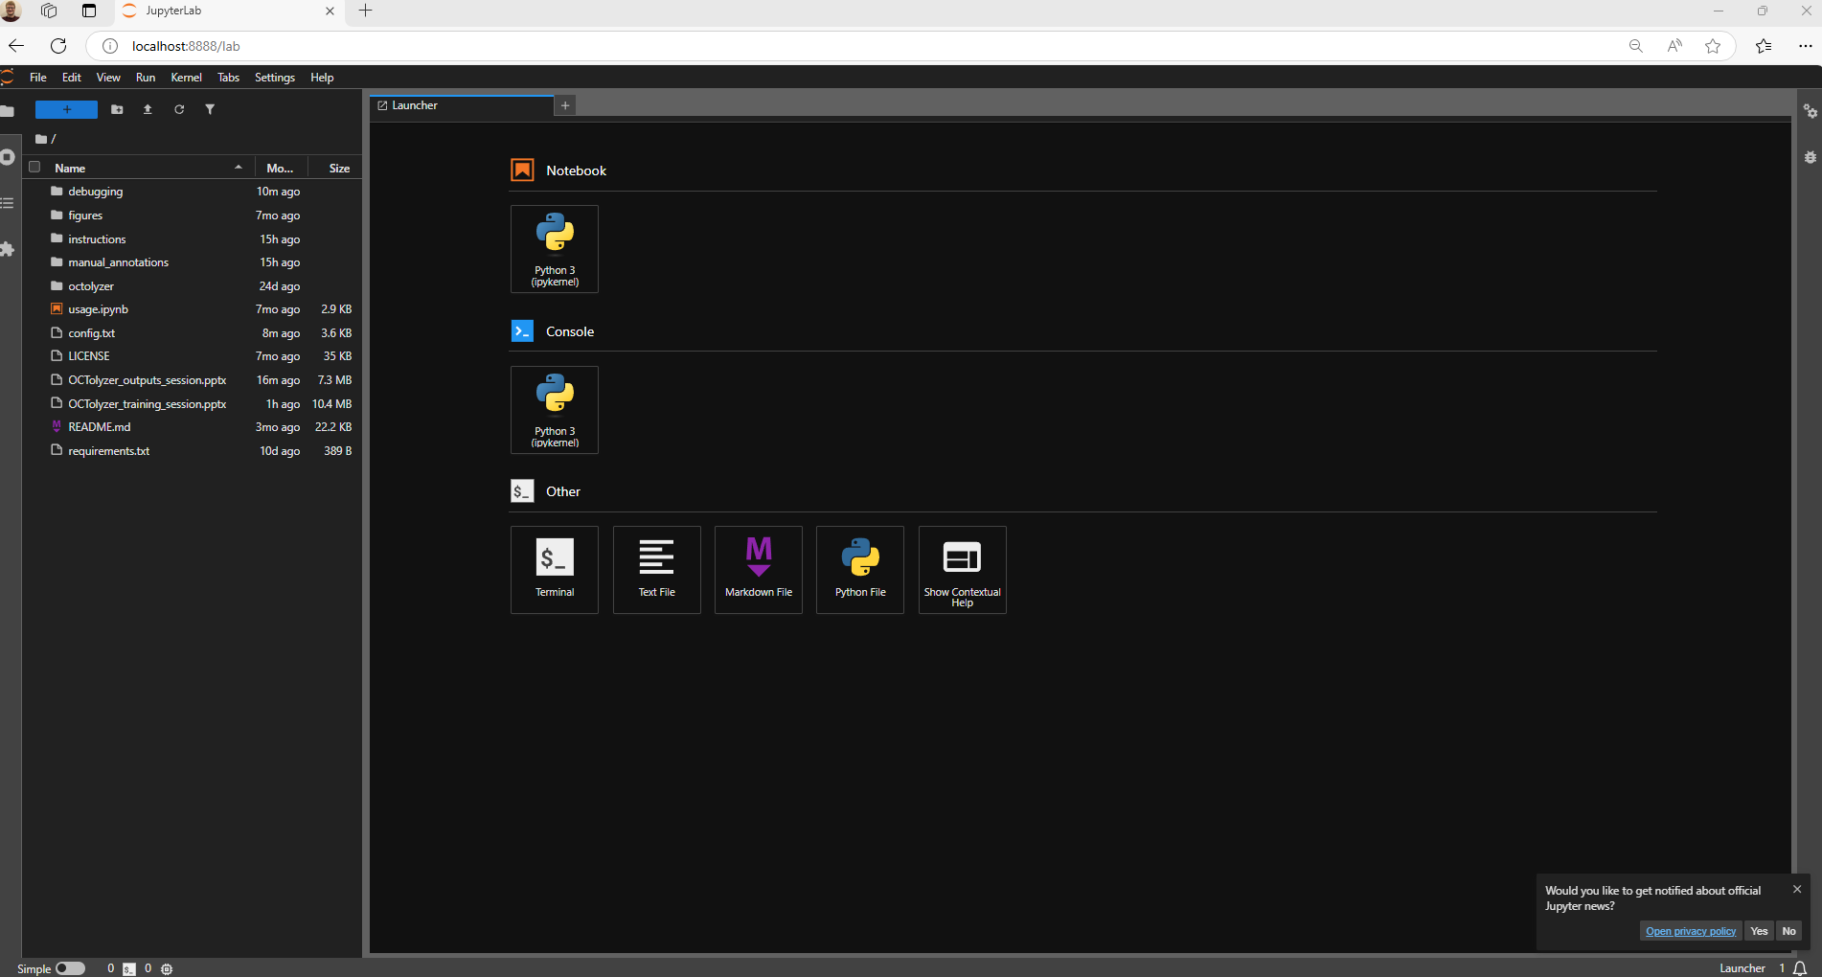
Debugging on jupyter (1/2)
If a .vol file fails unexpectedly or parts of its processing fails, you can run the debugger debug_{scan_type}.ipynb for this particular file to understand at what point of the pipeline the software fails.
To load up a debugger notebook for H-line/V-line B-scans, load Anaconda Prompt and run 4 commands:
Navigate to OCTolyzer using cd path/to/OCTolyzer and press Enter;
Type conda activate oct-analysis and press Enter;
Type jupyter lab and press Enter.
A web browser will automatically appear with the a directory structure and interface to run Python interactively

Slide 9
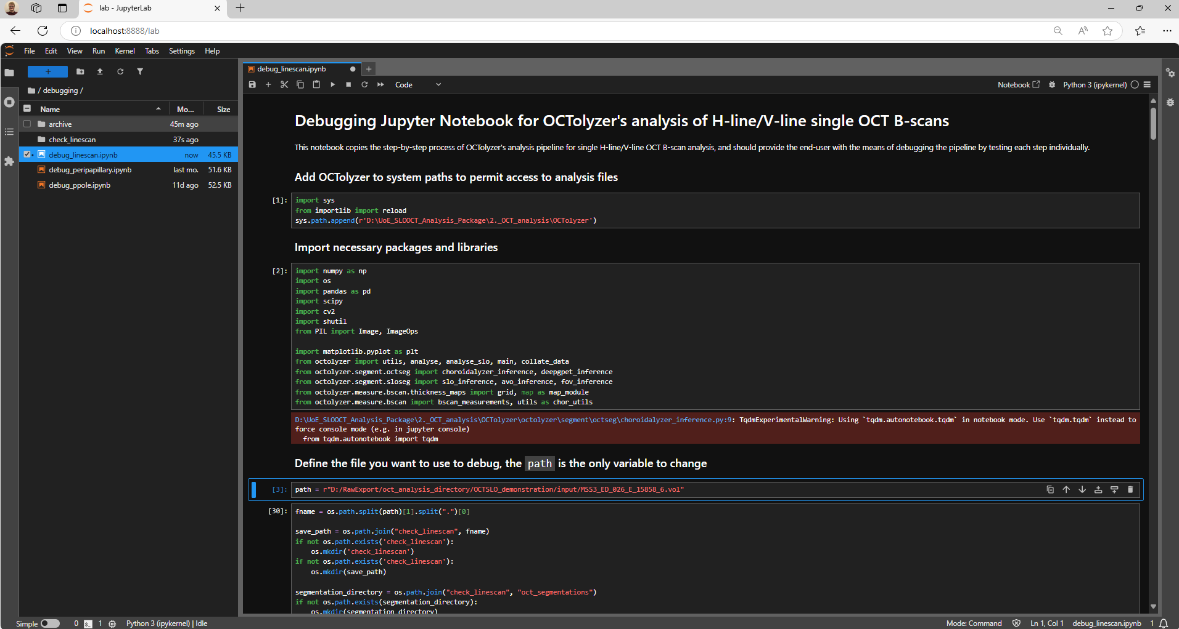
Debugging on jupyter (2/2)
To run the debugger, follow these steps on the jupyter host:
Navigate to the debugging/ directory and open debug_linescan.ipynb.
Change the file path to the .vol file you wish to debug OCTolyzer with. This can be found in the third cell of code.
Run each cell of the notebook until you reach the failure point.

Slide 10
Manual correction for OCT data (1/1)
We provide support for manual correction of SLO segmentations, and for fovea detection on single H-line/V-line B-scans.
Manual correction requires ITK-Snap, and instructions are provided in the manual_annotation/ folder.
Saving out the .nii.gz files in the same folder as the original OCT fovea segmentation map and re-running OCTolyzer will update the measurements with the newly detected B-scan fovea.
In future, manual correction for the B-scan fovea on the Ppole will be available.
Enter: Demo.

Slide 11
OCTolyzer’s Outputs

Slide 12
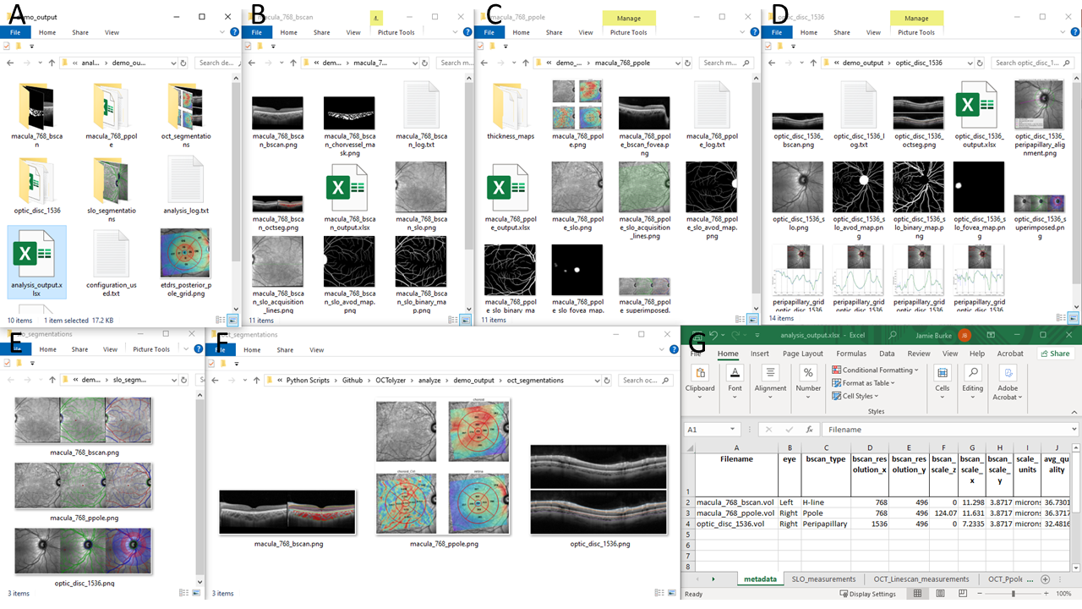
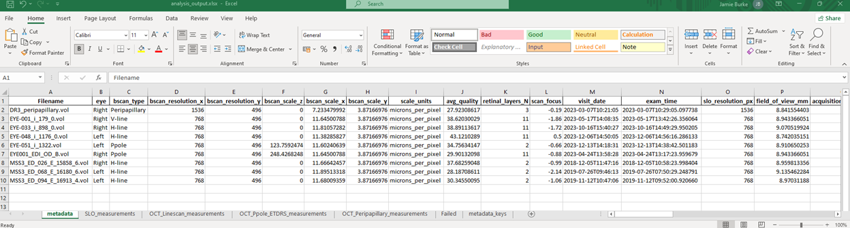
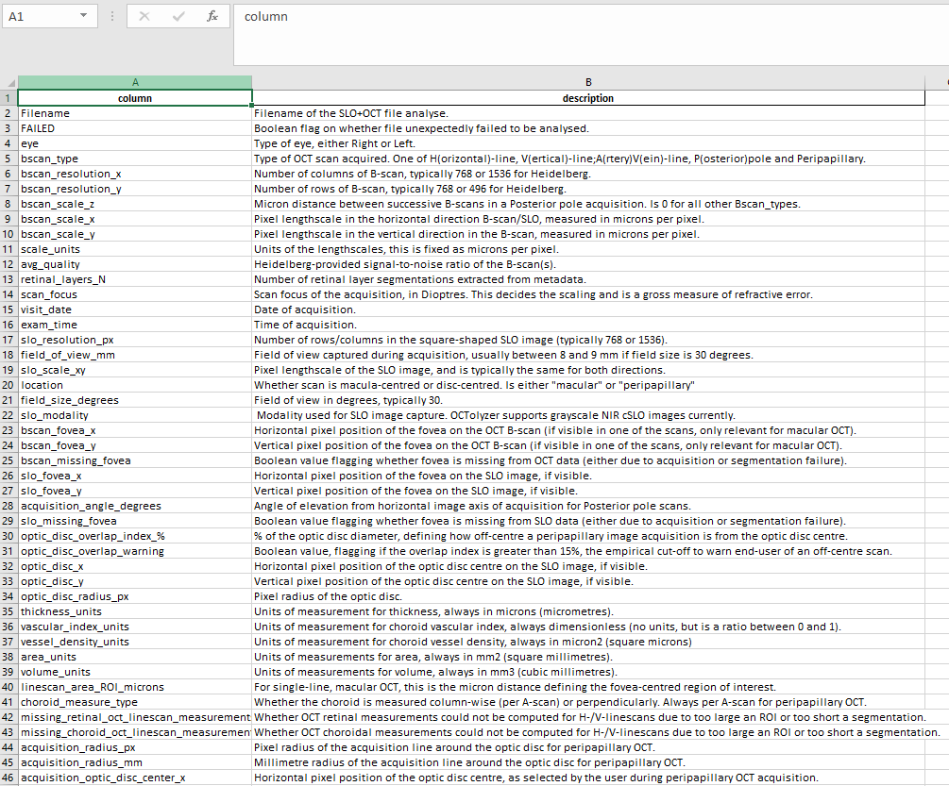
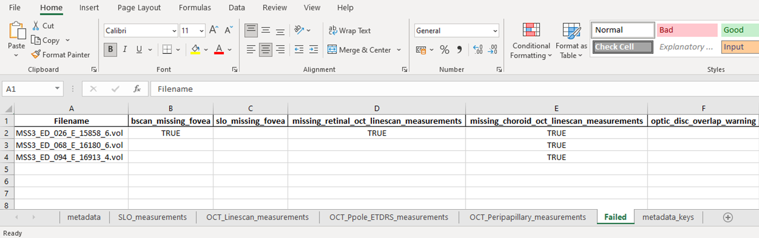
Outputs
A number of files/folders generated in the output folder:
A copy of the configuration setup used for the batch is saved out to promote reproducibility (A, red arrow).
A log file {filename}_log.txt which prints information on the pipeline’s processing and is useful for checking errors or missing values (A, blue arrow)).
Images of a demonstrative ETDRS grid (and 8x8 posterior pole grid if analyse_square_grid is 1) with codes overlaid for easy look-up on measurement sheet (following Heidelberg’s format) (A, orange arrow)).
The analysis_output.xlsx compiles all metadata and measurements for every file analysed in the input directory (A, green arrow).
There is a metadata_keys sheet in analysis_output.xlsx defining every column heading in the metadata sheet.
There is a Failed sheet in analysis_output.xlsx extracting each file which had a processing problem.

Slide 13
Outputs
Metadata sheet has important information on the success of the pipeline, including the columns with headings:
bscan_missing_fovea: If the choroid segmentation model failed to detect the fovea on the OCT B-scan, this will show TRUE. All measurements will fail as a result, and is mostly only relevant for H/V-line scan.
slo_missing_fovea: If the SLO segmentation model failed to detect the fovea on the SLO image, this will show TRUE.
missing_retinal_oct_linescan_measurements: Unexpected error in OCT retinal layer segmentations (or if bscan_missing_fovea is TRUE) results in measurements as -1s (or removed from sheet entirely), this shows TRUE.
missing_choroid_oct_linescan_measurements: Unexpected error in choroid layer segmentations (or if bscan_missing_fovea is TRUE) results in measurements as -1s (or removed from sheet entirely), this shows TRUE. Could be due to poor segmentation which doesn’t cover entire region of interest specified.
FAILED: If the pipeline had an unexpected error during processing a file, this will show TRUE.
optic_disc_overlap_warning: If the optic_disc_overlap_index_% > 15, this will show TRUE, i.e. the peripapillary scan was off-centre during acquisition by at least 15% of the optic disc diameter.
A separate datasheet “Failed” stores these columns separately for quick look-up of any processing issues OCTolyzer underwent.

Slide 14
Outputs
Firstly, inspect the oct_segmentations and slo_segmentations (if analyse_slo is 1) for segmentation quality (E,F below).
More information and visualisations can be found in each file’s output folder, named {filename} (B,C,D below):
Metadata & measurement xlsx file {filename}_analysis_output.xlsx
Segmentation masks, thickness maps, overlaid segmentations onto the SLO/OCT scans.
Individual log file {filename}_log.txt which prints information on the pipeline’s processing and is useful for checking errors or missing values.

Slide 15
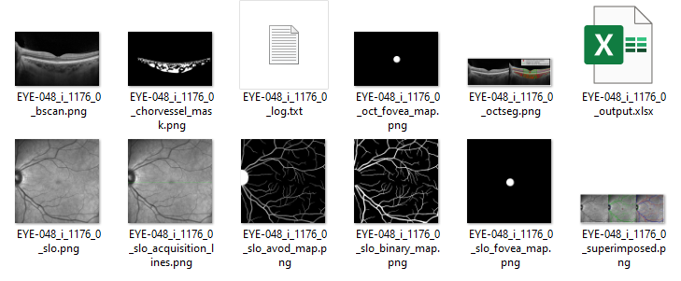
Linescan Outputs
In the output folder:
Individual B-scan.
Choroid vessel segmentation mask.
Log file.
OCT B-scan fovea segmentation map.
This can be manually corrected on ITK-Snap.
Visualisation of OCT segmentations and ROI measurement.
This is most important for visually checking processing of OCT.
Output excel file with metadata and measurements.
This is most important for quantitatively checking processing of OCT.
Individual SLO image.
SLO image with B-scan acquisition location superimposed.
SLO Artery-Vein-Optic Disc segmentation map.
This can be manually corrected on ITK-Snap.
SLO All-Vessel (binary) segmentation map.
This can be manually corrected on ITK-Snap.
SLO Fovea segmentation map.
This can be manually corrected on ITK-Snap.
Visualisation of SLO segmentations.
This is most important for visually checking processing of SLO.

Slide 16
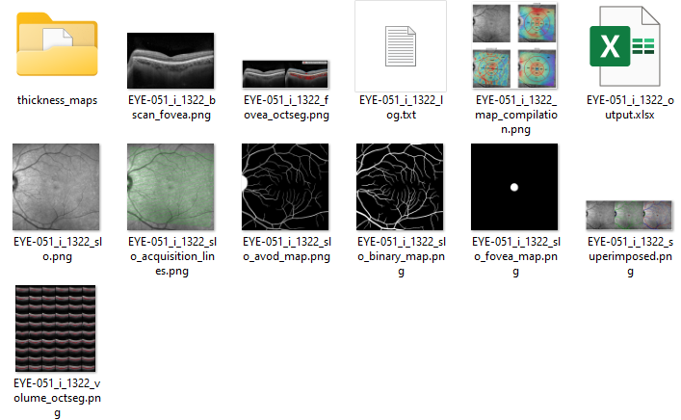
Ppole Outputs
In the output folder:
Folder of:
Thickness map visualisations and raw values (saved as .npy’s)
Choroid vessel segmentations masks (saved as .npy’s)
Individual, fovea-centred B-scan.
Fovea-centred B-scan with segmentations overlaid.
Log file.
Thickness map visualisation of retina and/or choroid.
Output excel file with metadata and measurements.
This is most important for checking processing of OCT.
Individual SLO image.
SLO image with B-scan acquisition locations superimposed.
SLO Artery-Vein-Optic Disc segmentation map.
This can be manually corrected on ITK-Snap.
SLO All-Vessel (binary) segmentation map.
This can be manually corrected on ITK-Snap.
SLO Fovea segmentation map.
This can be manually corrected on ITK-Snap.
Visualisation of SLO segmentations.
This is most important for visually checking processing of SLO.
High-resolution image of ndividual B-scans of Ppole stitched together with segmentations overlaid.
This is most important for checking segmentations of OCT.

Slide 17
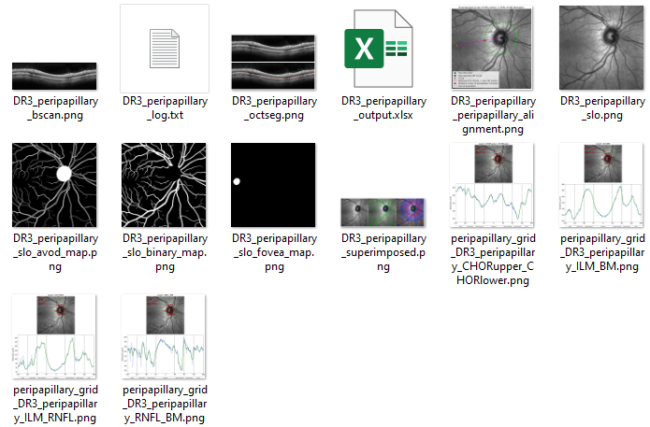
Peripapillary Outputs
In the output folder:
Individual B-scan.
Log file.
Visualisation of OCT segmentations.
This is most important for checking segmentation of OCT.
Output excel file with metadata and measurements.
This is most important for quantitatively checking processing of OCT.
Visualisation of aligning the peripapillary grid using the detected optic disc and fovea (on the SLO).
Individual SLO image.
SLO Artery-Vein-Optic Disc segmentation map.
This can be manually corrected on ITK-Snap.
SLO All-Vessel (binary) segmentation map.
This can be manually corrected on ITK-Snap.
SLO Fovea segmentation map.
This can be manually corrected on ITK-Snap.
Visualisation of SLO segmentations.
This is most important for visually checking processing of SLO.
Thickness profile and visualisation of peripapillary thickness measurements in each peripapillary subfield for:
Choroid, Retina (ILM – BM), RNFL (ILM – RNFL) and remaining layers (RNFL – BM).

Slide 18
FAQs (1/2)
What if my computer crashes mid-run?
The pipeline saves results as it runs, so you can simply carry on where you left off, by launching Anaconda Prompt and running OCTolyzer again with the same configuration.
What if I need to restart my analysis?
Delete the output folder and run OCTolyzer as before.
What if I need to only re-process a single file?
Delete the output folder of that specific file and run OCTolyzer as before.
What if I forgot to add another file to a previously processed batch?
Simply add the file to the input directory and re-run OCTolyzer. Assuming the output directory is the same as before, all previously processed files will be skipped during processing but loaded into the final output file.
How do I correct SLO segmentation errors?
Instructions are available to use ITK-Snap to correct retinal vessel segmentation.
Can I correct OCT segmentation errors?
Manual correction of OCT choroid/retina segmentations are currently not supported. However, correction of the OCT B-scan fovea is supported currently for H-line/V-line B-scans via ITK-Snap, in the same way as for correcting SLO segmentation maps.

Slide 19
FAQs (2/2)
Why did one of my files fail?
Check the folder’s {filename}_log.txt file for an error traceback. If competent, run the corresponding debugging jupyter notebook on the file, located in OCTolyzer/debugging/check_{scan_type}.ipynb.
Why are there -1s in the measurement results?
Only relevant for H-/V-line scans, and means that the measurements failed due to poor segmentation or too large a region of interest specified. Check the segmentation visualisation in the file’s output folder.
Why are there NAs or empty cells in the metadata sheet of analysis_output.xlsx?
This is because different scan types are being analysed in a single batch, and some columns are only relevant to certain scan types, i.e. linescan_area_ROI_microns is only relevant to H/V-line scans.
Why are the results of some files missing from their excel sheet in analysis_output.xlsx?
This is likely because these files failed to be analysed, check the columns mentioned in slide 20 to see if one of these have been flagged, or the Failed datasheet.
While metadata is saved out for every file, if measurements fail to be computed then they are not stored in the respective measurement sheet.
Why don’t my peripapillary results include measurements on the choroidal vessels?
This is because we use DeepGPET for peripapillary choroid analysis, which only segments the choroid region. This is because we have found DeepGPET to be more successful at peripapillary segmentation than Choroidalyzer.

